Slide 1
Instructions for playing the game.
Start the slide show from the beginning. There is a bit of audio for the first slide so have speakers on.
Click on the in the bottom right corner of the first slide to start the game.
Choose any category and question by clicking on the point value.
Read the question or statement on the slide.
Click on the in the bottom right corner of the slide to view the answer.
The moderator should use the key provided so they know whether or not to view the answer. If answer is not correct, allow another team or student to try.
Click on the to return to the Jeopardee board.

Slide 2
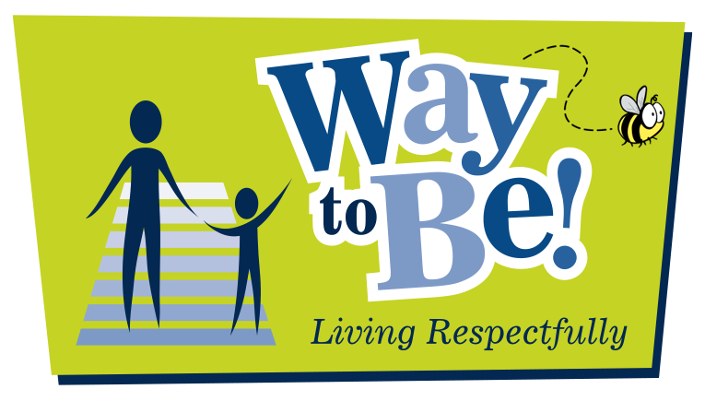
Traffic Safety Trivia

Slide 3
Choose a point value.
Choose a point value.

Slide 4
10 Points
10 Points
10 Points
10 Points
10 Points
20 Points
20 Points
20 Points
20 Points
20 Points
30 Points
30 Points
30 Points
30 Points
30 Points
40 Points
40 Points
40 Points
40 Points
40 Points
50 Points
50 Points
50 Points
50 Points
50 Points

Slide 5
If you cross the street other than corner or marked crosswalk, it is called this.

Slide 6
Jaywalking

Slide 7
If you are riding a bike, what do you do to cross the street at a crosswalk?

Slide 8
Walk the bike across

Slide 9
How can you make sure that a driver sees you before you cross a street?

Slide 10
Look the driver in the eye

Slide 11
Before you cross a street, you should always do this so you know it is safe.

Slide 12
Look in all directions

Slide 13
An AMA School Safety patroller is at the crosswalk after school. How do you know when to cross?

Slide 14
When the AMA School Safety patroller holds out their stop sign and says “Proceed.”

Slide 15
What are you using when you say things like please, thank you and excuse me?

Slide 16
Good manners

Slide 17
When a person is speaking, what should you be doing?

Slide 18
Listening

Slide 19
What can you do to show that you are listening to a person who is speaking?

Slide 20
Look at the speaker

Slide 21
What can you do when the drop-off zone at school is full with vehicles?

Slide 22
Get dropped off a few blocks away and walk from there.

Slide 23
What is a respectful thing to do if another person is entering a building behind you?

Slide 24
Hold the door for them

Slide 25
What is the area called where buses stop to let students on or off?

Slide 26
Bus zone or Drop zone

Slide 27
What is the spot called that is marked on a street to show you where to cross?

Slide 28
Crosswalk

Slide 29
The strap in a vehicle that is used to keep people safe is called this.

Slide 30
Seatbelt

Slide 31
What is the movement of vehicles on a street called?

Slide 32
Traffic

Slide 33
If you are listening to music, what should you do before you cross a street?

Slide 34
Take out your ear buds or remove your headphones

Slide 35
When riding a bike, you should always wear this.

Slide 36
A helmet

Slide 37
Where are two places that you may safely cross a street?

Slide 38
A crosswalk
A corner

Slide 39
You look between two vehicles and see your ride waiting across the street. What should you do?

Slide 40
Cross at the crosswalk or at a corner

Slide 41
An AMA School Safety patroller uses this object to help keep people safe as they cross the street.

Slide 42
Stop sign

Slide 43
What are three “P” words that every pedestrian should know?

Slide 44
Point Pause Proceed

Slide 45
Showing how we value and care about others is a way to display this?

Slide 46
Respect

Slide 47
Treating others as you want to be treated is known as this?

Slide 48
The Golden Rule

Slide 49
If you hurt someone’s feelings, what two things should you do?

Slide 50
Apologize Ask for forgiveness

Slide 51
An elderly person gets on a bus that has no empty seats. What should you do to show respect?

Slide 52
Offer your seat and stand

Slide 53
After a movie, what should you do with empty drink glasses or popcorn bags to show respect?

Slide 54
Put them in the garbage or recycle them

Slide 55
Final Jeopardee
Make your wager!

Slide 56
What is the main lesson that the Way to Be program teaches you?

Slide 57
To be respectful about traffic safety

