Slide 1
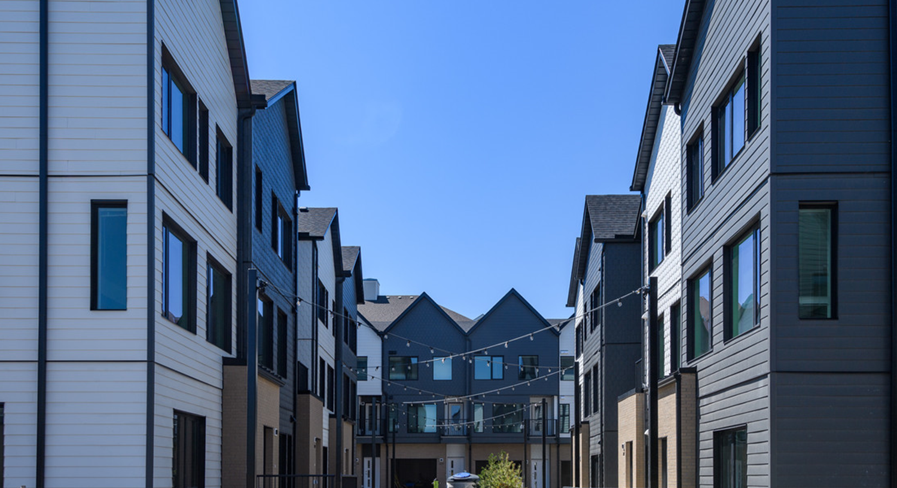


Partnering with Industry Symposium
February 24, 2022
Bruce Irvine – Manager of Affordable Housing, Calgary Housing (CH)

Slide 2
Thank you to our partners across the industry for your continued support in making life better for Calgarians thorough the provision of safe, affordable housing to low- and moderate-income households.
We are supporting individual and community well-being.
Notes:
We thank our partners across the industry as they play a key role in contributing to a Prosperous City. In the case of affordable housing, the private sector is responsible for building all new homes. In Calgary, we are meeting demand for affordable housing by leveraging the benefits of the public, private and non-profit sectors.

Slide 3
Contributing to - A Prosperous City
Affordable Housing’s contribution (2022-2026) approx. up to $360+ M (5%)
Notes:
The City’s Calgary Housing and partners contributes to …
A prosperous city –A prosperous city means that Calgary continues to grow and where The City invests in several services to support Calgary’s prosperity, including affordable housing. We support the delivery capital infrastructure to meet citizen priorities - $766M capital budget 11% of the overall capital budget
AH will be contributing between 2022 to 2026 with approximately up to $360+ million of capital budget which will be 5% of the overall Capital Investment.
We act as Project Managers, engaging private architects, planner, and contractors with a vision to build over 1,000 new affordable housing units by 2026.
The Affordable Housing development program creates a long-term development pipeline which prioritizes development projects, redevelopment projects, and lifecycle maintenance projects on City-owned assets.

Slide 4






The City’s Strategy
The City’s focus:
Get the Calgary community building
Leverage City land
Design and build new City units
Regenerate City-owned properties
Strengthen intergovernmental partnerships
Improve the housing system
Notes:
Through our Corporate Affordable Housing Strategy – Foundations for Home, that guides The City’s affordable housing direction for 2022 we work with partners to:
Get the Calgary community building.
Leverage City Land
Design and build new City units
Regenerate City-owned properties
Strengthen intergovernmental partnerships
Improve the housing system

Slide 5
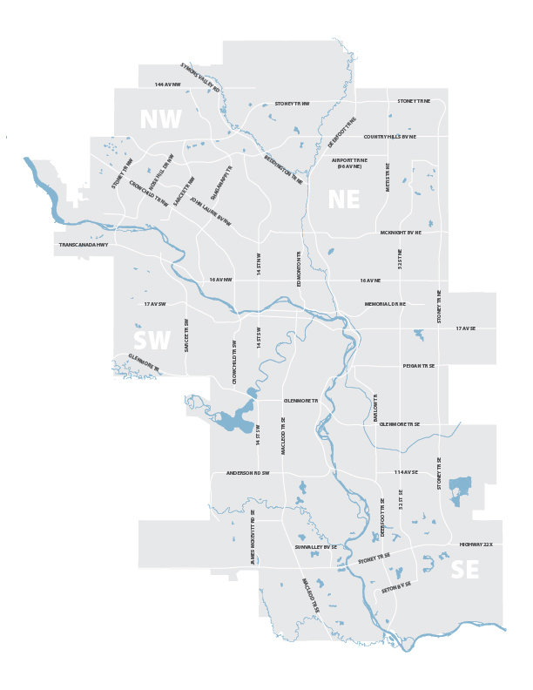
Progress
198 units completed (2018 - 2021)
Wildwood – 48 units
Bridlewood – 62 units
Rosedale – 16 units
Kingsland – 32 units
Crescent Heights - 16 units
Bridgeland – 24 units
Notes:
198 Units delivered between 2016-2021
With an estimated budget of $39M

Slide 6
Tendered RFPs
Rundle
Redevelopment and new affordable housing
135 Units
Contract: Stantec, Chandos
Mount Pleasant
New Affordable Housing
16 units
Contract: Chandos
Varsity
Integrated Civic Facility w/ affordable housing
48 units
Contract: MBAC
Notes:
Three recent projects have concluded their procurement as shown her e
We are excited that all three of these projects are already of will be underway by spring

Slide 7
Projects to be tendered
Marda Loop
New housing
20 Units
Bridgeland Place
Redevelopment
Min 210 Units
Southview
Redevelopment project
200 Units
Mission
New housing
20 Units
Symons Valley
Integrated Civic facility w/housing
48 Units
Cornerstone
Integrated civic facility w/housing
48 Units
Notes:
We are expecting over 550+ units to be completed with a total estimated budget of $155.5M to be tendered and delivered within the next business cycle (2023-2026)
Mention highlight of what we are looking for in these upcoming projects:
Information that might help contractors understand what we are looking for:
Can mention past projects: operational efficiency, energy efficiency, community connectiveness, integrated community spaces, etc.
How do they get on the list to be considered for residential contractors, how are these advertised?)

Slide 8
Rapid Housing Initiative
$41.2M (announced to date) initiative for Calgary.
Four projects to build 260 new affordable homes:
    Silvera for Seniors Redevelopment
    HomeSpace Society Redevelopment
    Horizon Housing Society
    HomeSpace Society Conversion
    Note: Tendered/To be tendered by housing provider
Notes:
On December 17th, 2021, the Honourable Ahmed Hussen, Minister of Families, Children and Social Development and Minister Responsible for Canada Mortgage and Housing Corporation (CMHC), and Naheed Nenshi, the Mayor of Calgary, announced details of the $24.6 million Rapid Housing Initiative allocation for Calgary.
As part of its Investment Plan for the Major Cities Stream, Calgary submitted the following three projects, led by three different non-profit housing providers that will build 260 new affordable homes:
Silvera for Seniors redevelopment began partial occupancy in 2021; a hotel conversion into a seniors’ residence with 120 units when fully completed.
HomeSpace Society redevelopment opened 25 units in 2022.
Horizon Housing Society opened 33 units in 2022.
HomeSpace Society office to residential conversion will open in 2022.
The successful non-profit organizations will be moving forward very quickly to complete these projects, and there may be significant opportunities to support through consulting, trades and other services required as they build out these new homes.
(Mention accelerator fund - )

Slide 9
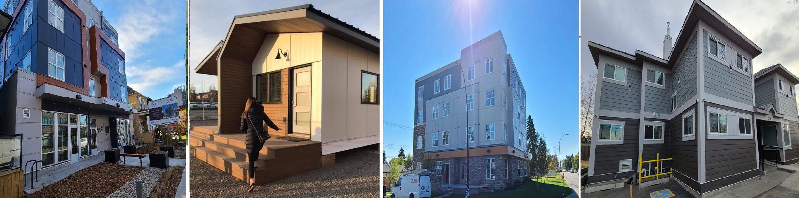
Non-Market Land Sale
Leveraging land through recent land sales.
So far, 9 parcels of land have been sold (potential to create more than 300 new homes).
A further release of land is expected within the next year.
Notes:
The City of Calgary has a Council-approved policy that allows for the sale of up to 10 parcels of surplus City-owned land at below market value to experienced non-profit affordable housing developers every two years. The program will run again in 2022 and could offer up to 9 parcels of developable land.
We are also leveraging land through our most recent land sales to non-profit organizations; enabling these non-profits to look for partners to help them build in the next two years.
The sale of these sites is currently underway and, once completed, the successful groups will begin community engagement and the required planning approvals. The groups may also shortly be beginning the process of identifying the necessary consultants, trades and services needed to complete the construction of these homes.

Slide 10
Calgary Housing Company: Lifecyle Investment in Housing
$21.8M capital investment in 2022 for housing regeneration and maintenance
Key word search Calgary Housing Company on Alberta Purchasing Connection www.purchasingconnection.ca and MERX www.merx.com
Notes:
CHC is the largest residential landlord in Calgary managing over 200 properties owned by The City, the Province and CHC with approximately 7,100 units – providing homes to nearly 25,000 Calgarians in need of affordable housing.
Calgary Housing Company relies on industry partners to deliver services and has approximately $50M annually in operating contracts; most services are outsources to private local companies. In 2021, CHC has planned an estimate $47.58M on 93 procurements (including contract renewals and non-capital items).
The contracts are tendered directly by CHC.
CHC’s procured services include construction and maintenance: sidewalks, asphalt, fencing, general contractor work, mechanical construction, roofing, envelope construction, interior renovations, utilities consulting and construction, demolition, engineering and consulting contracts etc
CHC anticipates an estimated $10 - $20 Million per year of capital work from 2022-2026.
CHC’s procurements are posted online on both MERX and Alberta Purchasing Connection under Calgary Housing Company. (will Bo be able to attend for Q and A and Paula in the break-out groups for any questions about CHC procurement)

Slide 11
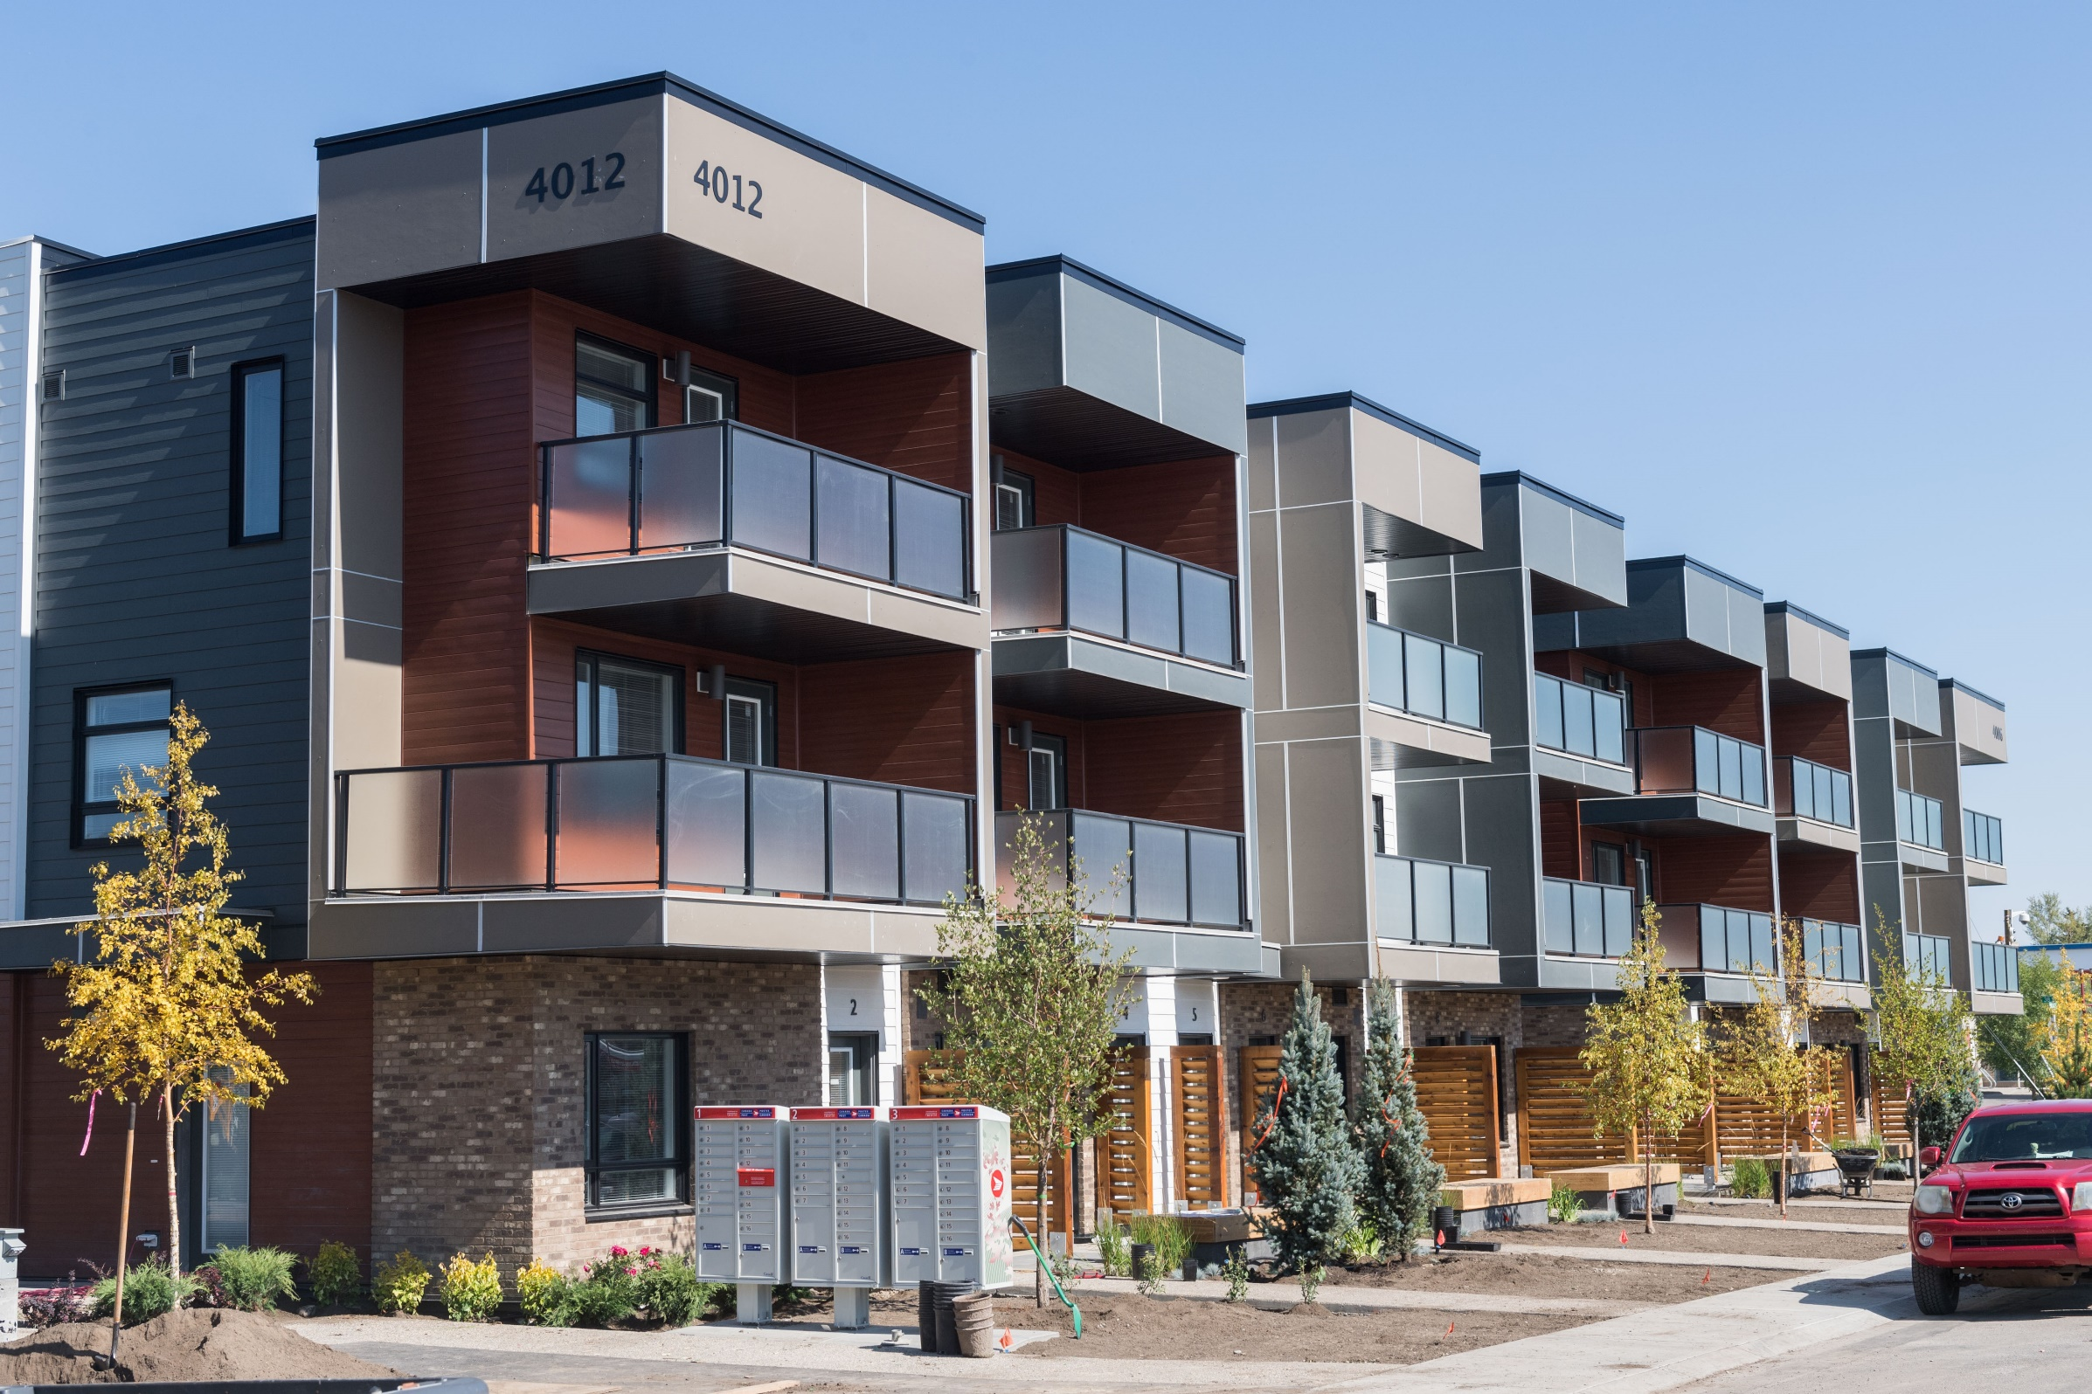
New Federal Programs
CMHC expected to announce new RHI funding 2023-2024 ($1B+).
CMHC expected to revise co-investment program.
City is working with federal government on the new $4B housing accelerator program.
Notes:
We are optimistic that this work could be significantly enhanced as the federal government is now detailing several potential engagement to the national housing strategy including a $600M office to residential conversion and the housing accelerator program which will offer cities additional funding for increased residential growth.
City is working with federal government on the new $4B housing accelerator program which could contribute significantly to Calgary construction.

Slide 12
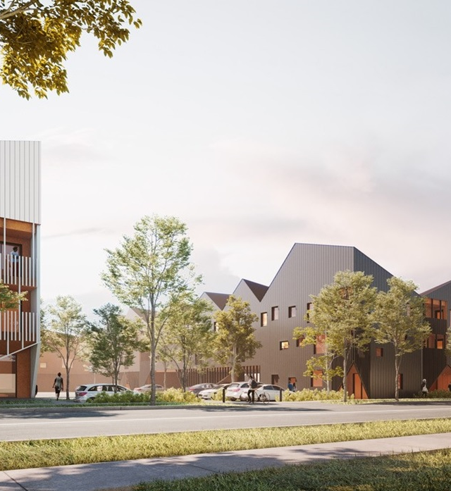
Next for Calgary Housing
Q2 2022:
Conversations with council on the new capital plan and four-year budgeted program
Notes:
In Q2-2022 we’ll start conversations with council on our new capital plan and our four-year budgeted program to build our next generation of affordable housing.
We are thankful to industry for partnering with us to build new housing in Calgary.

Slide 13

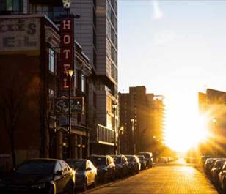

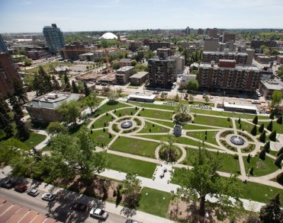
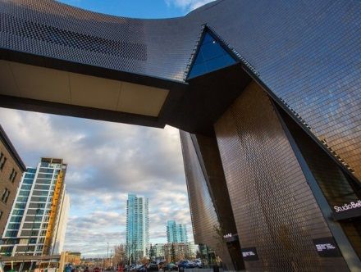
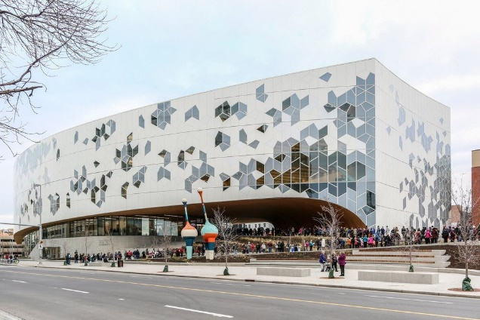


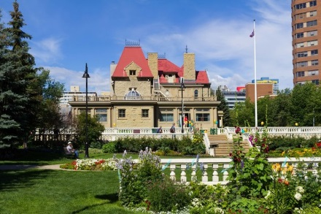
Thank-you

