Slide 1
ALBERTA INFRASTRUCTURE 2022 Partnering with Industry Symposium February 24, 2022
Notes:
Thank you Erin and also to the City of Calgary for inviting me to this symposium. My name is Max Amodio and I’m the Director of Procurement at Alberta Infrastructure.
I’d like to first express my appreciation to the many of the design, consulting and construction organizations on the call today. In 2020-21 Alberta Infrastructure completed 190 projects with a value of just under $1.4 Billion all during a pandemic and we could not have done that without the work of so many fine companies here in Calgary and the surrounding area.

Slide 2
Budget 2021 Capital Plan www.alberta.ca/capital-plan
Capital $21.6 billion over three years (2021-24 Capital Plan)
$6.1 Billion for Direct Municipal Support
$3.4 Billion for CMR of Public Infrastructure
$2.2 Billion for Roads and Bridges
$2 Billion for Health Facilities
$1.7 Billion for School Projects
Notes:
The ironic timing of this presentation is that any minute now the government will announce its budget for 2022 so the specifics of this information will be replaced soon enough but it does give you a sense of where funding comes from, how dollars are allocated and where to find additional information if you’re interested.
I’ll start by talking about where the money is coming from then get to some of the projects.
The Budget 2021 Capital Plan increased by $937 million to $21.6 billion over 3 years and is allocated as follows:
$6.1 billion for direct municipal support
$3.4 billion for capital maintenance and renewal of public infrastructure
$2.2 Billion for Roads and Bridges
$2 billion for health facilities
$1.7 billion for schools
Information about the budget can be found at www.alberta.ca/capital-plan

Slide 3
2021 Capital Plan Projects
14 school projects and five new health care projects.
Other projects include:
LaCrete Maternity and Community Health Centre
Cyclotron facility in Calgary.
New Court of Appeal in Calgary.
Safety upgrades to the David Thompson Highway Corridor.
Bragg Creek Flood Mitigation project,
Increased investment in the Modular School Program
Mount Royal University Repurposing Existing Facilities project.
Notes:
The Capital plan will also mention specific projects.
Among the stimulus and recovery projects in the 2021 Capital Plan are 14 school projects and five new health care projects, including the La Crete Maternity and Community Health Centre and the cyclotron facility in Calgary.
In addition, there is funding for the new Court of Appeal in Calgary, safety upgrades to the David Thompson Highway Corridor, the Bragg Creek Flood Mitigation project, increased investment in the Modular School Program, and the Mount Royal University - Repurposing Existing Facilities project.
The Capital Plan will also continue to support economic recovery by investing an additional $375 million in each fiscal year of 2022-23 and 2023-24 in future strategic projects to support Alberta’s Recovery Plan.

Slide 4
Investing in Canada Infrastructure Program
Alberta has been allocated $3.66 billion.
5 non-COVID projects, over $40 million.
Since program launched, 85 non-COVID projects approved totaling $2.99 billion.
$115.2 million allocated to COVID stream.
shovel-ready CRM and renewal projects to improve health and seniors care facilities and other publicly owned infrastructure.
21 CMR bundles approved, totaling $95.2 million.
Alberta Transportation.
91 projects totaling $103.5 million.
Notes:
Another source of funding is the Investing in Canada Infrastructure Program.
• Alberta has been allocated $3.66 billion through ICIP.
• 5 non-COVID projects have been approved to date in 2021-22, totaling over $40 million.
o Since the program launched, 85 non-COVID stream projects have been approved, totaling $2.99 billion.
• The province allocated $115.2 million of ICIP funding towards the COVID stream, launched in 2020. This funding is being used to support shovel-ready capital maintenance and renewal projects to improve health and seniors care facilities and other publicly owned infrastructure.
o 21 capital maintenance and renewal (CMR) bundles have been approved since the COVID stream launched, totaling $95.2 million.
•Over at Alberta Transportation they allowed municipalities with unused Public Transit stream allocations the option to transfer some or all of their allocations to the COVID stream, for their own use. Most of the eighteen municipalities with Public Transit allocations transferred some or all of their allocations to the COVID stream, to be used towards higher priority infrastructure projects, enabling these municipalities to benefit from the 80% federal cost share under the COVID stream. Transportation has seen 91 municipal COVID stream projects approved, totaling $103.5 million.

Slide 5
Alberta’s Recovery Plan
This multi-phase plan will:
Strengthen our workforce; Grow our Resources; Build for the Future; Help Everyday Albertans and Diversify our Economy.
Highlights of the Recovery Plan include:
Infrastructure projects support more than 50,000 direct and 40,000 indirect jobs.
Getting Albertans back to work – Alberta Jobs Now Program.
Alberta 2030: Building Skills for Jobs strategy.
Innovation Employment Grant.
Notes:
Budget 2021 includes Alberta's Recovery Plan which is intended to breathe new life into Alberta's economy and create new opportunities for every Albertan. It's a plan to build, to diversify, and to create jobs.
This multi-phased plan will focus on 5 areas:
Strengthening our Workforce
Growing our Resources
Building for the Future
Helping Everyday Albertans
Diversifying our Economy
Highlights of the Recovery plan include:
The Infrastructure projects discussed earlier will support more than 50,000 direct and 40,000 indirect jobs through to 2024.
Getting thousands of Albertans back to work through the Alberta Jobs Now program by helping businesses offset the cost of hiring and training unemployed or underemployed Albertans in new or vacant positions.
Making sure our province is ready to meet the increasing demand for highly skilled workers in all sectors of the economy through the Alberta 2030: Building Skills for Jobs strategy
Providing grants of up to 20% for companies to use toward qualifying research and development expenditures.

Slide 6
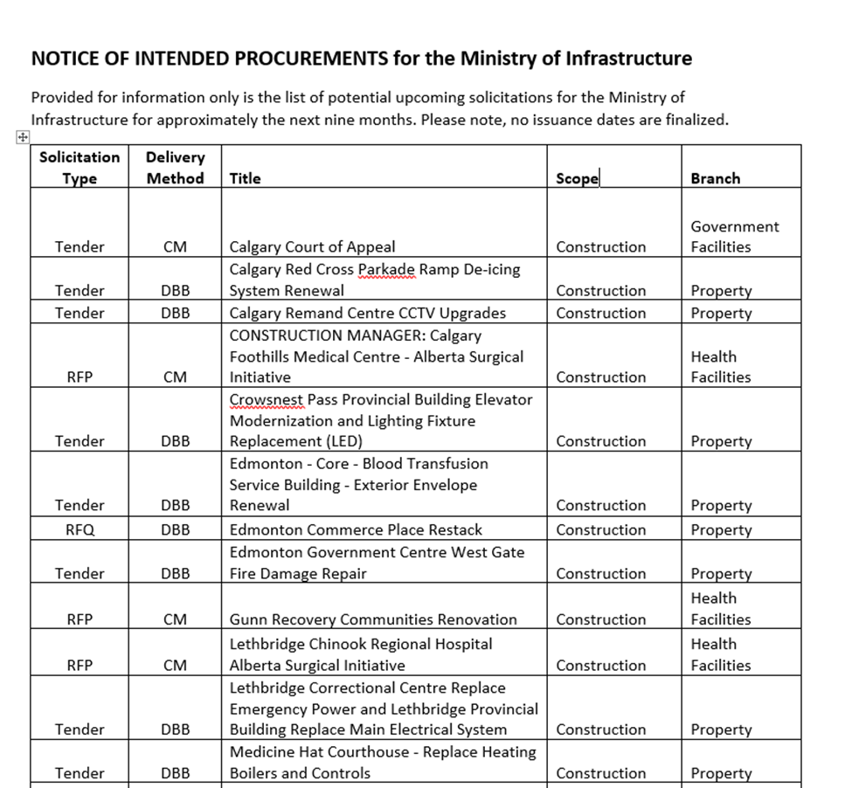
Procurement Notifications
Notes:
Infrastructure has started posting monthly Notices of Intended procurement on the Alberta Purchasing Connection website (at purchasingconnection.ca).
Provided for information only is a list of potential upcoming solicitations from the Ministry of Infrastructure over approximately the next nine months.
The information we provide on each notice is the solicitation type (Tender, RFP or RFQ), project delivery method, title of the project, whether it’s construction or Services and finally, the Branch responsible for managing the project.
Please note, no issuance dates are finalized.
The last notice was posted just about a month ago and it included 30 projects in total, 20 construction and 10 services. Projects of note include:
Calgary Court of Appeal
Construction Manager for the Calgary Foothills Medical Centre Surgical Initiative.
Calgary Remand Centre CCTV Upgrades
Brooks P. Duncan Hargrave Building Air Handling System replacement and mechanical systems controls
Lethbridge Chinook Regional Hospital Alberta Surgical Initiative
Rock Mountain House Surgical Initiative
To name a few

Slide 7
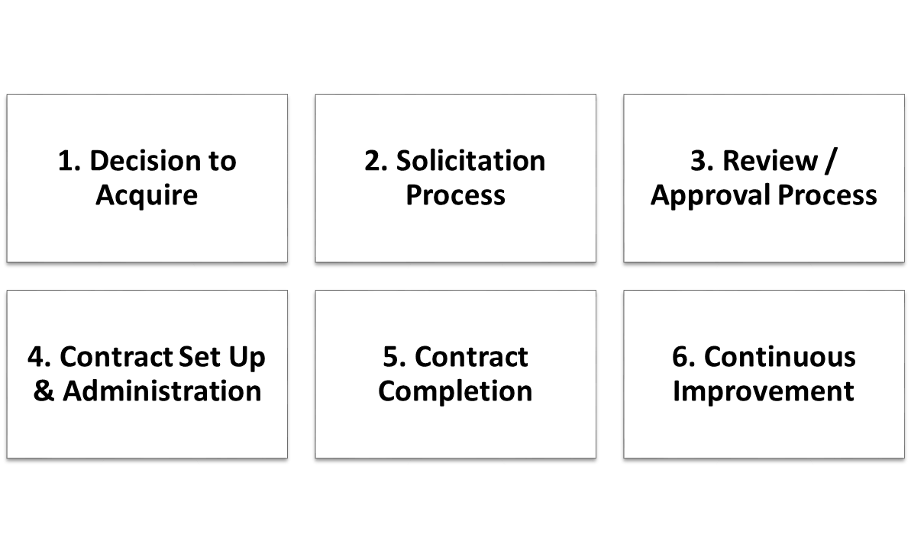
Procurement Process
Procurement Accountability Framework
6 procurement and contracting process elements
Notes:
A little about the procurement process we follow.
The government of Alberta is required to follow applicable trade agreements, Treasury Board Directives and acts when procuring public projects. The procurement accountability framework is a government document that sets out guidelines for all ministries to follow when issuing public procurements and I’ll discuss the steps we follow now.
The Decision to acquire for Alberta Infrastructure is achieved with the approval of the Capital Budget. This allows project teams to move to the next step which is the solicitation process.
Procurement and project managers develop a procurement plan to determine the best way to procure each contract, including:
Open Solicitation – procurements over trade agreement thresholds (budget estimate of $75,000 for consulting and $100,000 for construction);
Limited Solicitation – used for under threshold procurements, with a minimum of three firms invited to bid on the procurement; and
Sole-Source – used in situations where only one vendor can provide the service or other reasons that may support procurement without a competitive process.
Procurement and project teams consider which procurement approach will achieve the best outcomes and develop documents for public procurement. Approach options include:
Tenders. Lowest price based award,
Request for Qualifications (RFQ)s. - used to short list qualified vendors to bid on procurements.
Request for Proposal (RFP). Qualifications are scores. Decision to award is on more factors than price alone.
Standing Offer/Pre-Qualification Request (PQR) - used to register qualified vendors on a source list (similar to RFQ).
Procurement opportunities are posted through the Alberta Purchasing Connection (APC) website.
During each posted period, the process permits interested proponents to ask questions and seek clarification.
APC posts all addenda to APC.
Evaluation teams score submissions using an evaluation matrix containing standard and additional criteria. Common criteria include project team experience and qualifications, company experience on similar projects, project management methodology, and risk management approaches.
The evaluation used reflects on specific project outcomes.
The procurement team oversees the evaluation team through the process of scoring each submission.
The proponent is awarded the project and extended the contract for their signature.
A debrief opportunity is provided to all proponents upon request. The Procurement team provides high-level feedback with respect to a proponent’s proposal and specific comments relating to each of the evaluation criteria. Comparison to other submissions content or scores of any other vendor’s submission is not discussed.
A fully executed contract begins project work.
Infrastructure uses past experience and comments received during debriefs to continuously improve processes.

Slide 8
Alberta’s 20-Year Strategic Capital Plan
The 20-Year Strategic Capital Plan provides:
long-term, transparent, and strategic vision for how government plans and prioritizes the infrastructure needed to support vital programs and services for Albertans.
strategic foresight on key provincial infrastructure sectors
review of trends that influence infrastructure, such as technology and partnerships.
The Plan supports:
long-term comprehensive cross-ministry planning beyond the horizon of the annual Capital Plan.
ensures that government is active in strategic foresight.
understands the major trends that will impact Alberta as they relate to capital infrastructure.
The Plan was informed by public and stakeholder input and research from other jurisdictions and organizations.
Notes:
Alberta’s 20-Year Strategic Capital Plan sets the broad direction for Alberta’s infrastructure beyond the horizon of the annual Capital Plan in the budget.
It outlines the trends and themes that will shape Alberta’s future over the next two decades, such as technology and partnerships, while providing strategic foresight on key provincial infrastructure sectors, such as highways; schools; and hospitals.
The Plan does not contain specific projects or funding levels, as the annual Capital Plan contains specific project details.
Long-term strategic capital planning is a best practice from other Canadian and international jurisdictions, such as Ontario, Australia and the United Kingdom.
The goal was a Plan that both reflected and synthesized key priorities and strategies to provide a long-term capital planning vision for the entire government.
The ongoing renewal of the Plan every four years supports long-term comprehensive cross-ministry planning beyond the horizon of the annual Capital Plan, and supports government’s strategic foresight and understanding of the major trends that will impact Alberta as they relate to capital infrastructure.
In summer 2020, we invited Albertans to get involved in ensuring the Province has the right infrastructure in place to meet future needs.
Throughout the seven-week engagement, government received over 3,200 survey responses and written submissions from stakeholders and Albertans.
We will continue to gather input from stakeholders and Albertans in the development of future versions of the 20YSCP.

Slide 9
Procurement Contacts
Max Amodio Erika Washington
Director, Procurement Executive Director, Technical Services Alberta Infrastructure and Procurement
Max.Amodio@gov.ab.ca Erika.Washington@gov.ab.ca
780-913-6414 587-987-5379
Notes:
And I’ll end today with my contact information along with my Executive Director Erika Washington. If you have any questions about anything you heard today please feel free to contact me.
Infrastructure occasionally require completion of smaller construction projects that are estimated to be less than trade agreement thresholds of $100,000. In those cases we can invite firms to bid on projects. There is no guarantee of work but if you’re interested please send your company information to me.
Thank you again for the time today and I look forward to another successful year working closely with the members of the Calgary design, consulting and construction industries.

